Slide 1

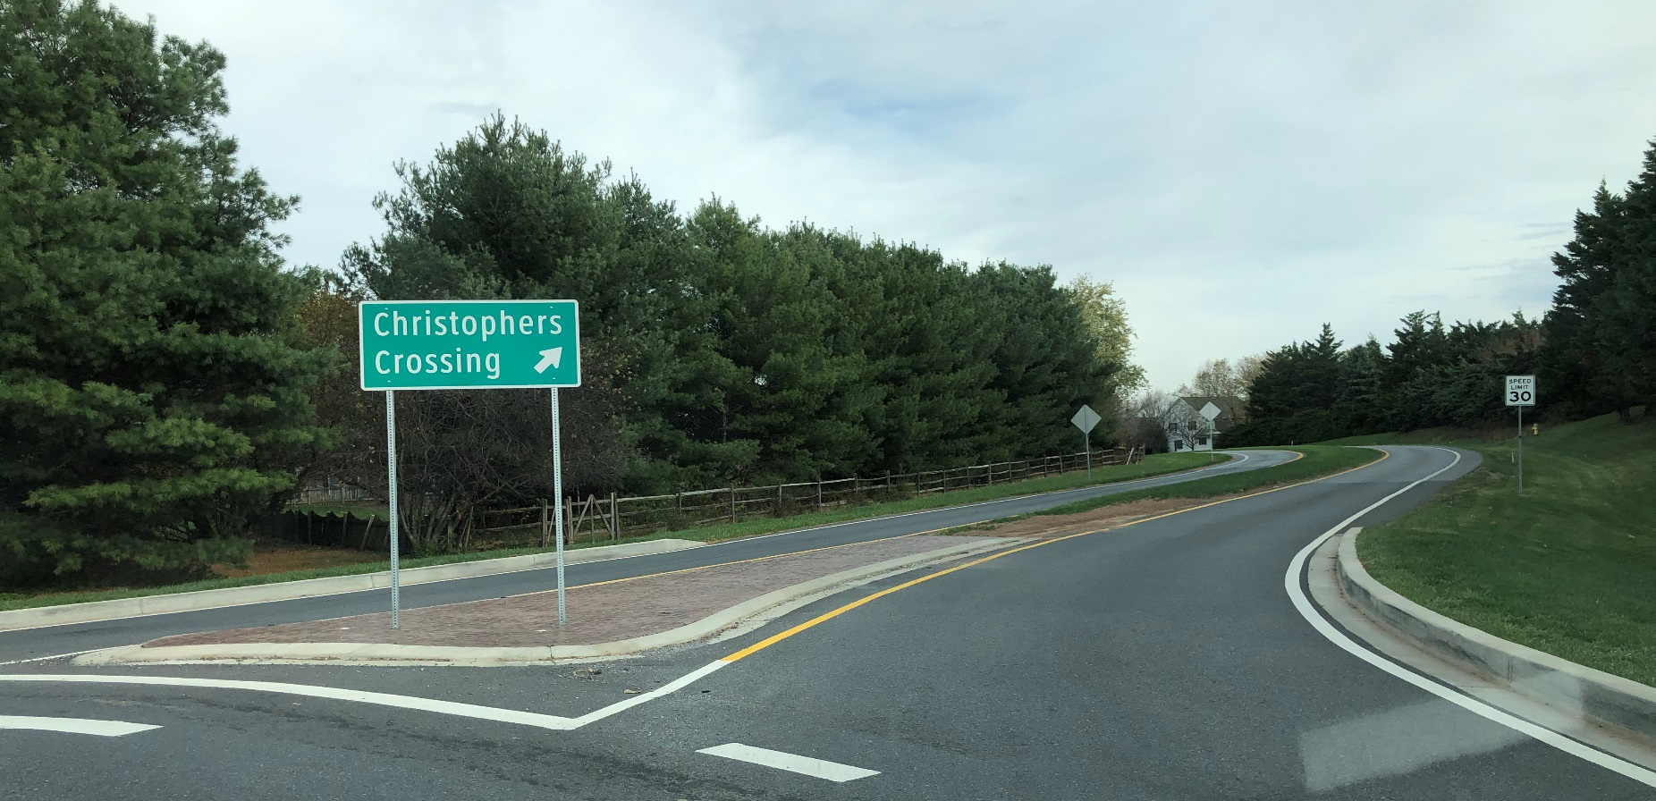
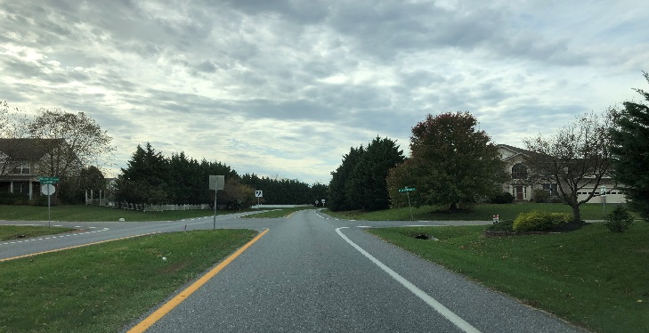

Christopher’s Crossing Widening Project
PUBLIC VIRTUAL MEETING Thursday, Dec 17, 2020
Notes:
Welcome to Frederick County’s…
“This will be a short presentation and at the end of the presentation, we will take a few questions or comments from the public for the time that we will have left.”
As a reminder, you can call
Dial 1-855-925-2801
Enter Code 8656
Press * for Meeting Options
Press 1 to listen to the meeting
Press 2 to record a comment
Press 3 to be placed in a muted queue to speak during the meeting
You must state your name and address at the beginning of your phone call, message or voicemail for your message or voicemail to be presented during the meeting. Please do not say your phone number as this will be made public.

Slide 2
Project Team
Elbert Maravilla - Project Manager
Ian Selock- Engineer
Jason Stitt, P.E. – Office Chief
Michelle Hurney - Facilities & Property Acquisitions Manager
A. Morton Thomas and Associates, Inc. (AMT) – Design Consultant
Notes:
Introduce self, Ian, Jason, and Michelle and AMT
Staff contact information is available at the project website, the link will be given at the end of the presentation.

Slide 3
Project Overview
Roadway widening improvements of Christopher’s Crossing from Walter Martz/Poole Jones to Whittier Drive
Improvements
Roadway widening from 2 to 4 lanes
Pedestrian crosswalk on 3 intersections
Drainage improvements
New 10’ wide pedestrian/bike path
New 5’ sidewalk
Notes:
Scope of work remains the same
Upgrade from a two-lane median divided roadway to a four-lane median divided roadway
Pedestrian crosswalks at Stone Ridge Drive, Glen Heather Drive, Jordan Valley Way
Change from open ditch to closed storm drain system (curb and gutter)
Install a 5’ sidewalk and a 10’ multi purpose pedestrian/bike trail

Slide 4
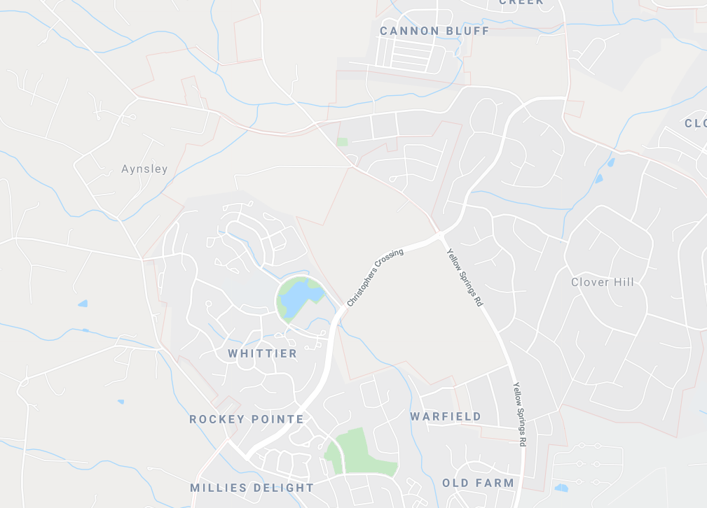
Project Location Map
Walter Martz /
Poole Jones
Whittier Drive
Notes:
Project limits will be approximately 1.2 miles of Christopher’s Crossing and will tie-in to the Frederick City sections at Walter Martz/Poole Jones intersection and Whittier Drive

Slide 5
Project Schedule
Design Phase
August 2019 - May 2021
Formal Acquisition of Easements/ROW
July 2021 – May 2022
Construction Phase
Invitation For Bids April 2022
Break Ground August 2022
Estimated Completion December 2023
Maintain Traffic during Construction
Notes:
We are still on schedule and are currently 60% complete of the design phase. We have now identified easements needed for each property along the roadway. We have managed for the most part to design within the County right of way so only a temporary easement is needed for minor grading to tie-in to your property to ensure proper drainage and slopes.
We have started communicating with homeowners to discuss property impacts and will start the formal acquisition phase soon after, around summer time.
Start of construction is anticipated to be August 2022 with an estimated completion date of December 2023

Slide 6
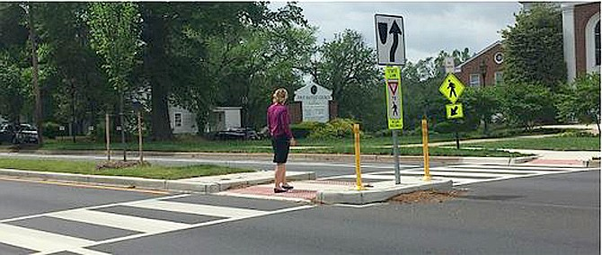
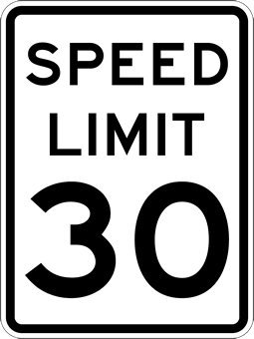
3 Pedestrian Crossings
Not an all-way stop
Signage
Speed Limit will be maintained at 30 mph
Traffic Calming (Narrow Lanes)
Sidewalk/Path & Grass Buffers
CROSSWALK DESIGN
Notes:
Due to concerns brought up during the first public meeting regarding pedestrian crossings, a traffic study was conducted by AMT to analyze if the crosswalks warrant all-way stops. The conclusion of the analysis does not warrant all-way stops for existing or future conditions of the intersections.
There will be ample pavement markings, advanced warning, and signage on the crosswalks.
For added pedestrian safety, a 3 foot grass buffer will be placed between the roadway and shared path/sidewalk.
Along the Frederick City section of Christopher Crossing (from Walter Martz to MD 26), City traffic engineers are planning on installing a traffic light at Opossumtown Pike and remove the all-way stop at Timber Grove and increase the speed limit to 30 MPH. With the development of the Frederick Health Campus, the intersections at Quincy Way/Frederick Health Way and Mill Pond Road will have traffic lights also.

Slide 7
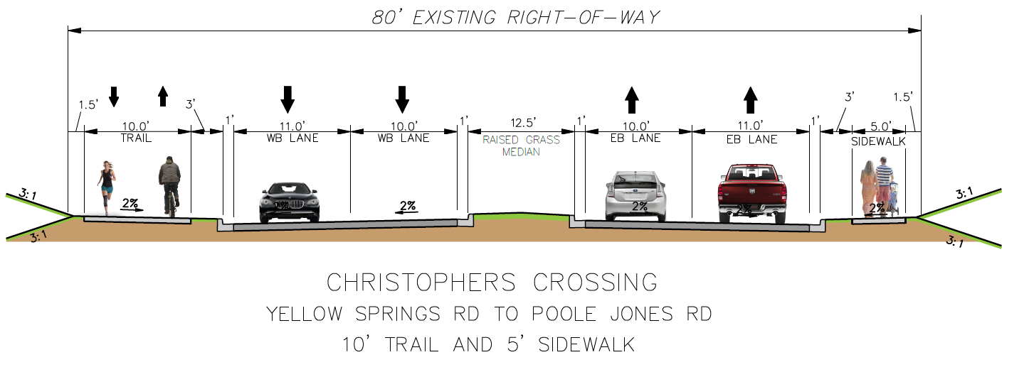
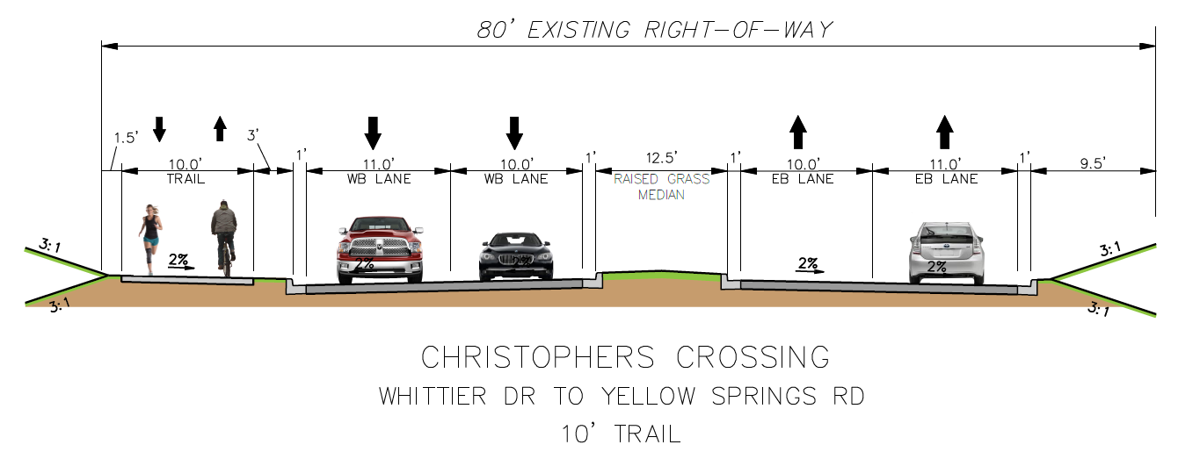
Typical Sections
Typical Section 1
Typical Section 2
Notes:
- We understand the concern of homeowners in the maintenance of both the 10 foot shared use path and 5 foot pedestrian sidewalk and we have been investigating for some time now, alternatives to the current County Code policy of having the adjacent homeowner responsible for maintenance, including snow removal.
- We have just recently concluded a successful agreement with the Department of Parks and Recreation, with the approval of the County Executive, to provide maintenance and snow removal for the 10 foot shared use path. That means property owners adjacent to the bike path will no longer be responsible for maintenance/snow removal.
- Unfortunately, on the 5 foot sidewalk side, we are still hopeful on coming up with an alternative plan.

Slide 8
Useful Link
Christopher Crossing project website:
https://www.frederickcountymd.gov/7858/Christophers-Crossing-Widening
Staff contact information
Current Plans
Public Meeting Minutes
Traffic Studies
Notes:
Here is our link to the project website. In it you will find staff contact information, current plans, meeting minutes, traffic studies, this presentation will be posted and meeting minutes will follow soon.
The link to our website can also be found in the letters that were sent out to residents and the Clover Hill Association newsletters

Slide 9
Questions
We will now open the meeting for questions
Meeting minutes from this meeting, including comments and responses, will be uploaded to our website.
Thank you!
Notes:
This concludes our presentation – we will now open the meeting for questions
This presentation will be posted in our website, and meeting minutes will follow soon.

