Slide 1
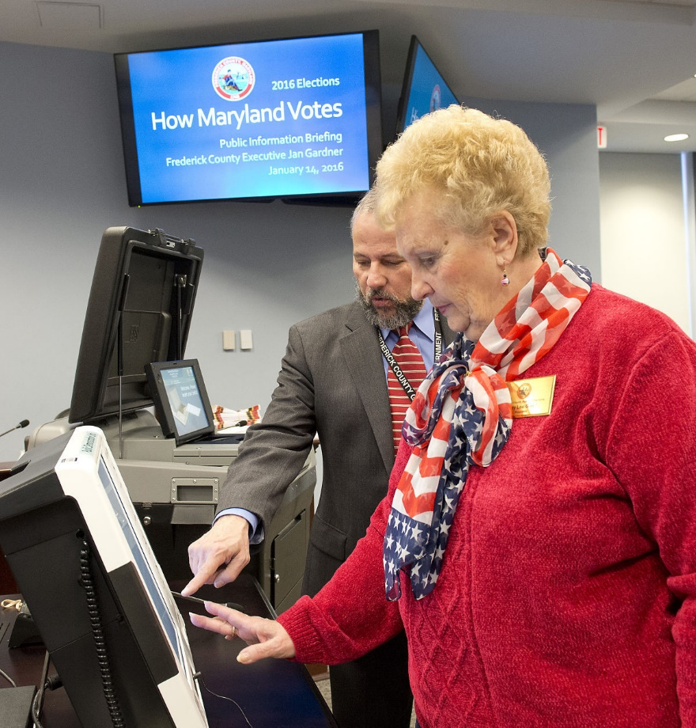

Redistricting: Implementation Role of the Board of Elections
Stuart Harvey, Election Director
Commission Meeting on June 30, 2021

Slide 2
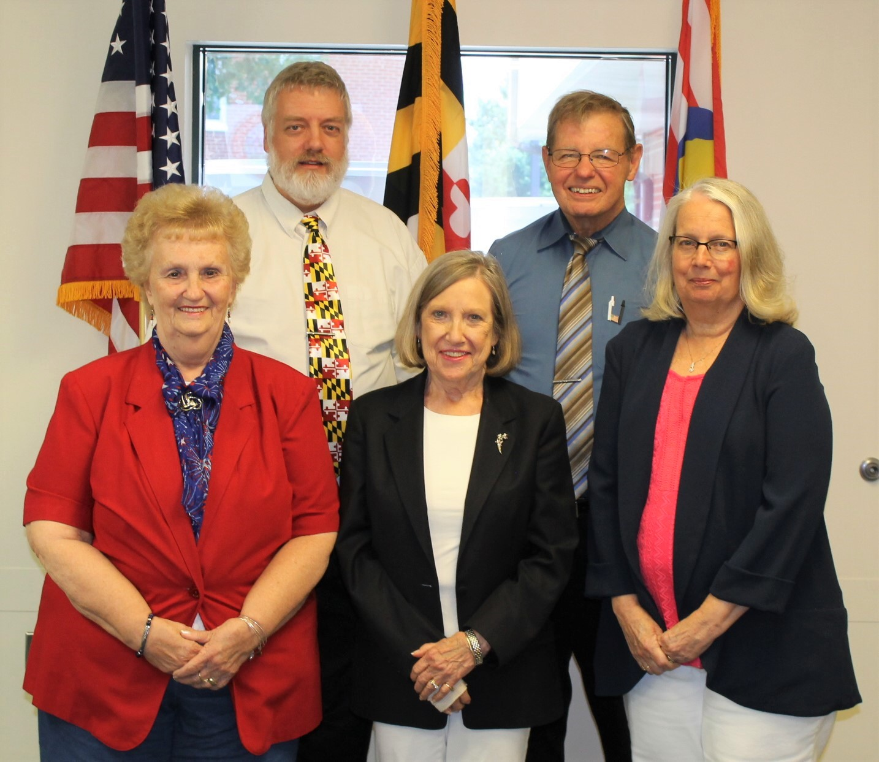
Frederick County Board of Elections
Who We Are
Defining Precincts
Election Geography
Calendar for 2021-2022

Slide 3
Frederick County Board of Elections
Annotated Code of Maryland, Election Law Article, Title 2: Powers and Duties of the State and Local Boards
State Board of Elections
“The State Board shall manage and supervise elections in the State”
County Board of Elections
“Each local board…shall oversee the conduct of all elections held in its county and ensure that the elections process is conducted in an open, convenient, and impartial manner…”

Slide 4
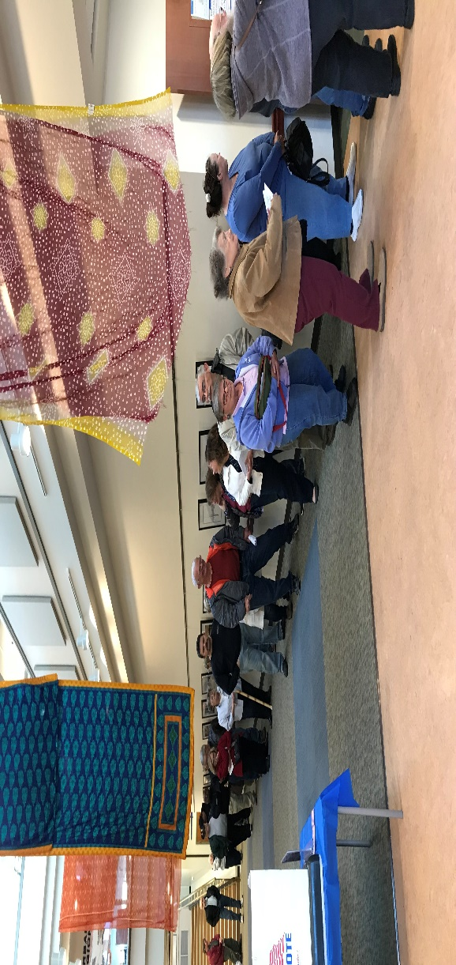
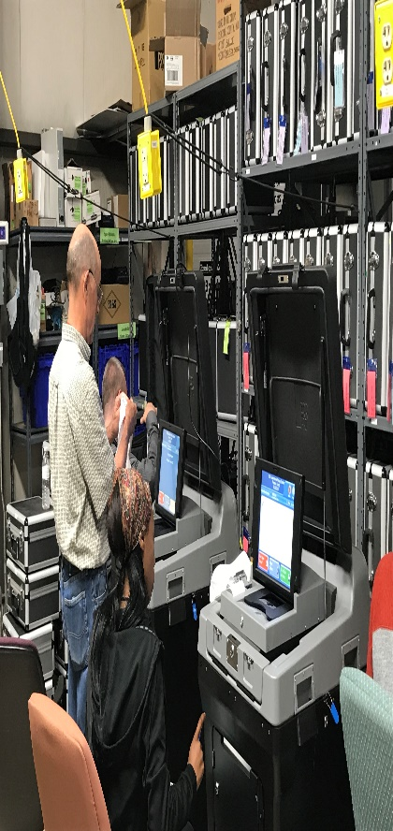
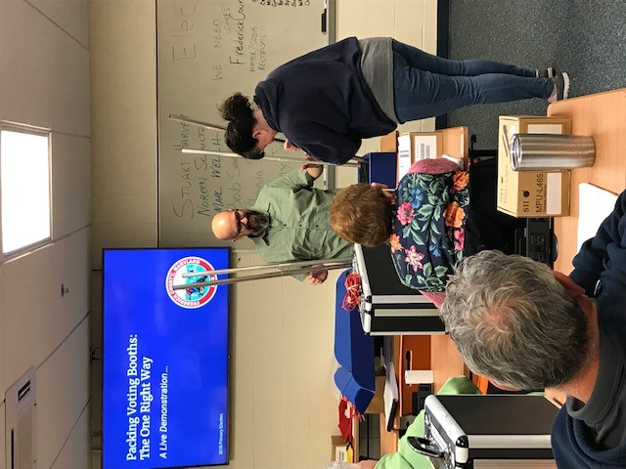
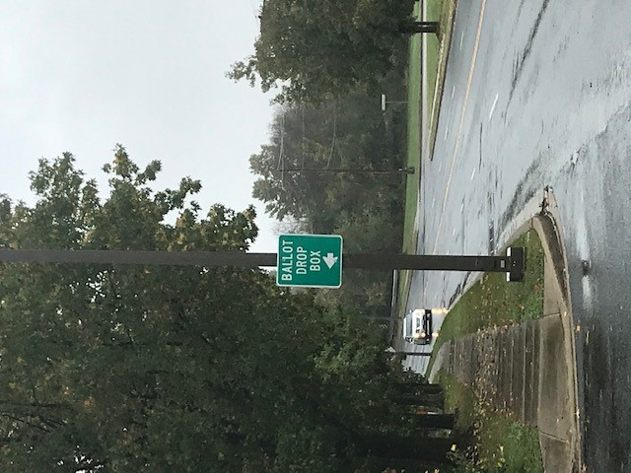
Frederick County Board of Elections
9 full-time staff
5 temporary staff
900 Election Judges
Duties include:
Registering voters
Administering elections, including:
Early Voting
Election Day
Voting by Mail
Auditing and certifying the accuracy of election results

Slide 8
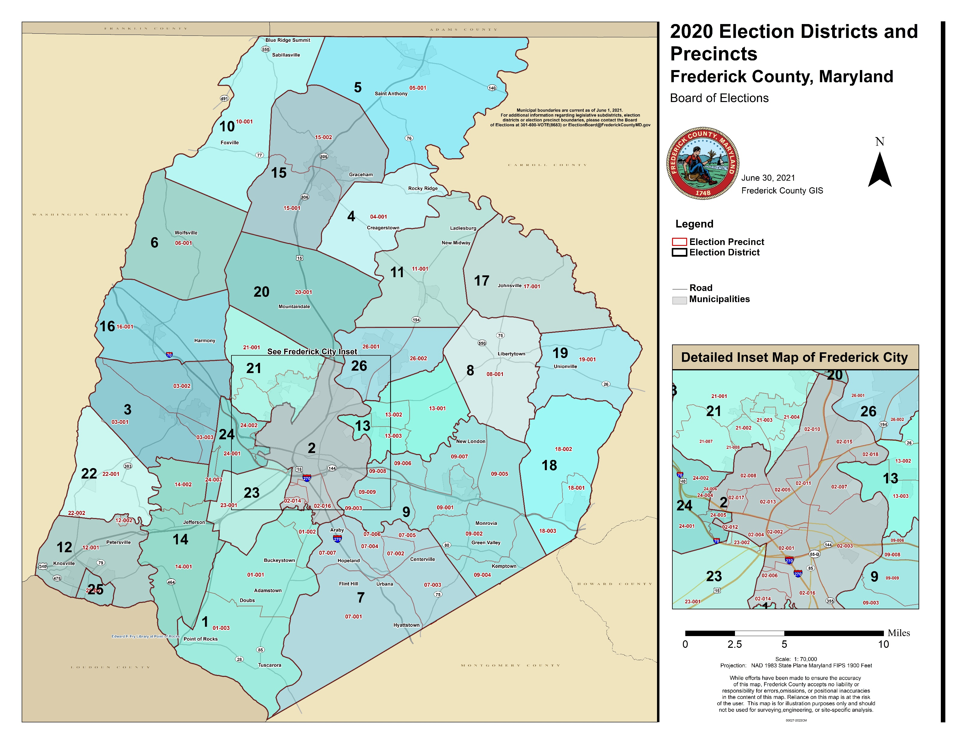

Slide 9
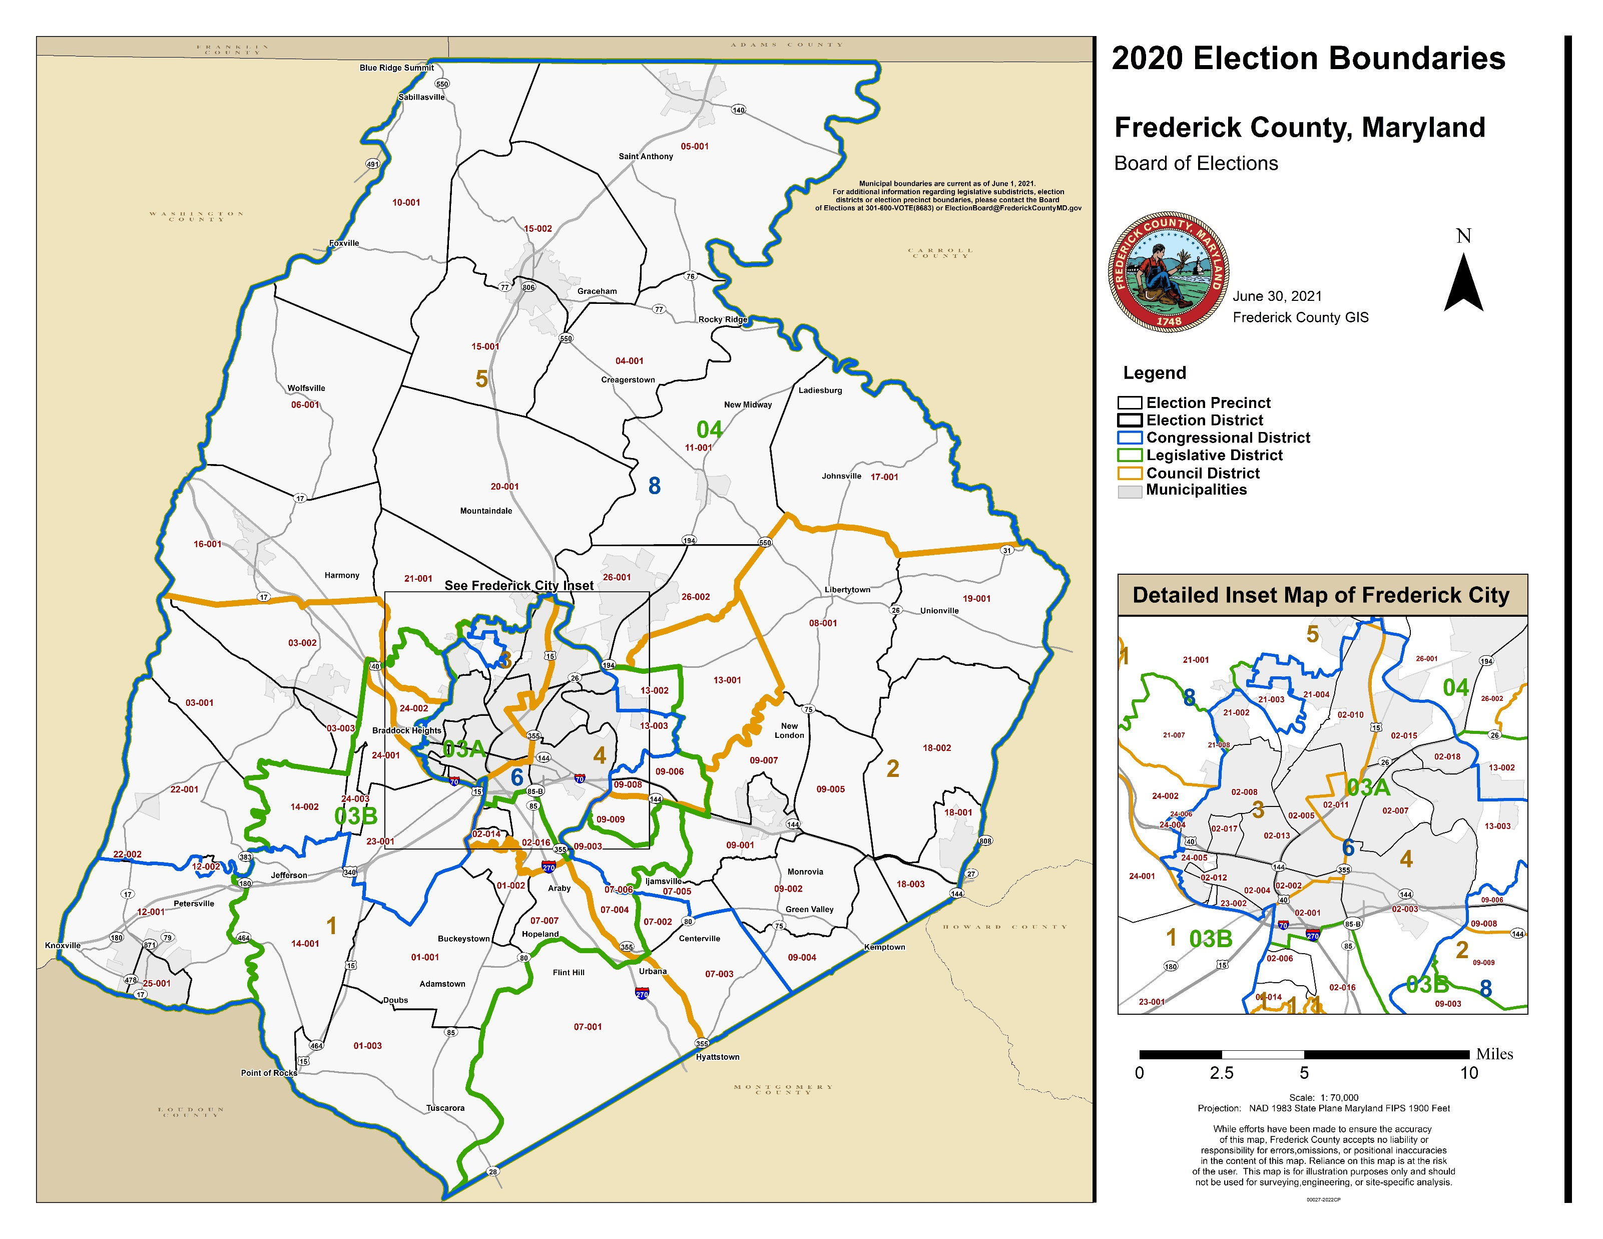

Slide 10
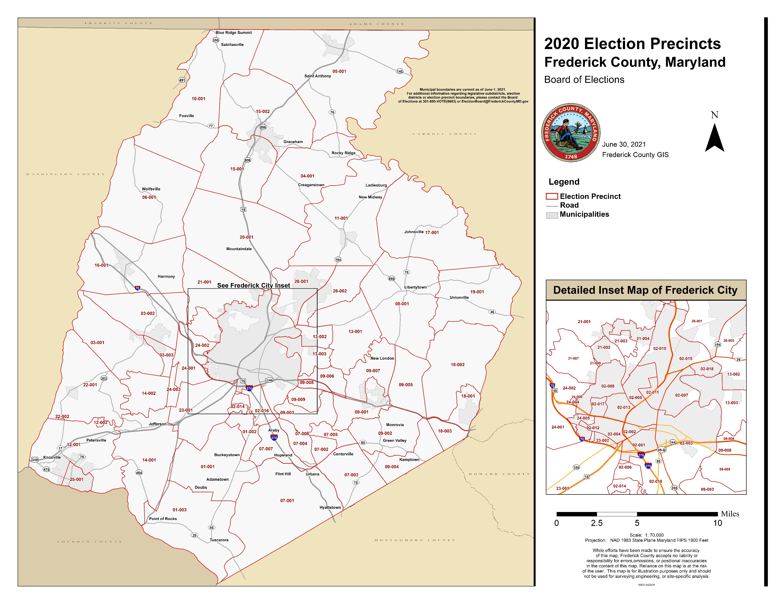

Slide 11
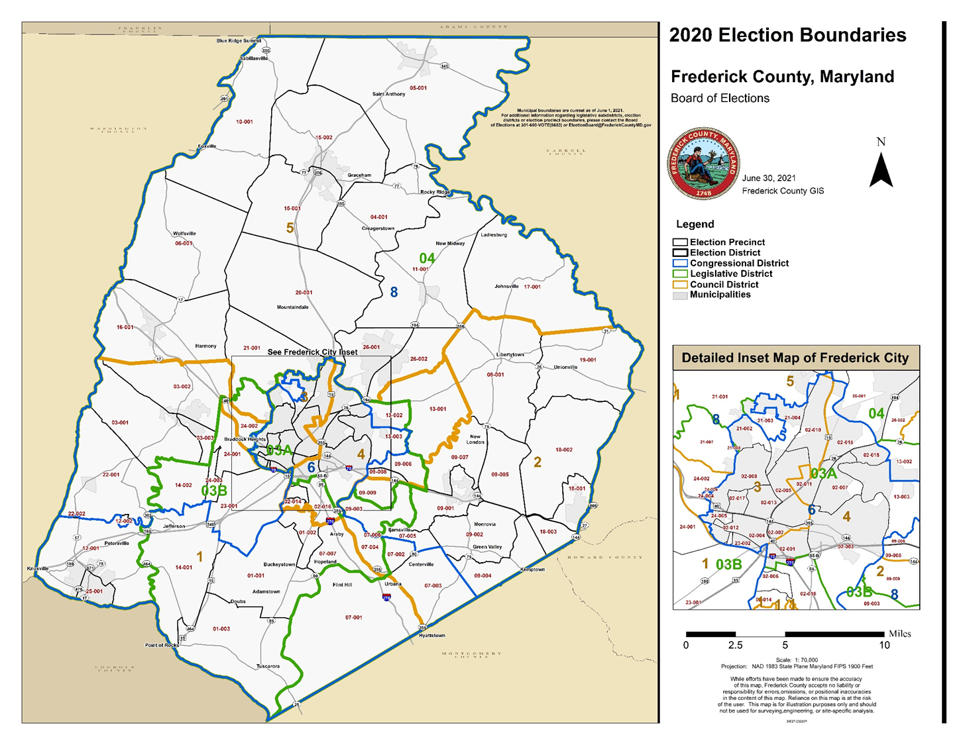
Defining Precincts and Polling Places
Considerations include:
Legal requirements
Availability of polling places
Factors that affect the voting experience such as:
Walkability
Parking
Precinct size
Room layout and capacity
Minimizing the extent of polling place changes

Slide 12
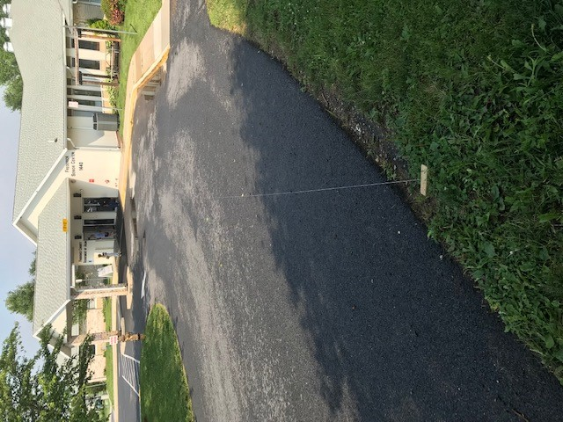
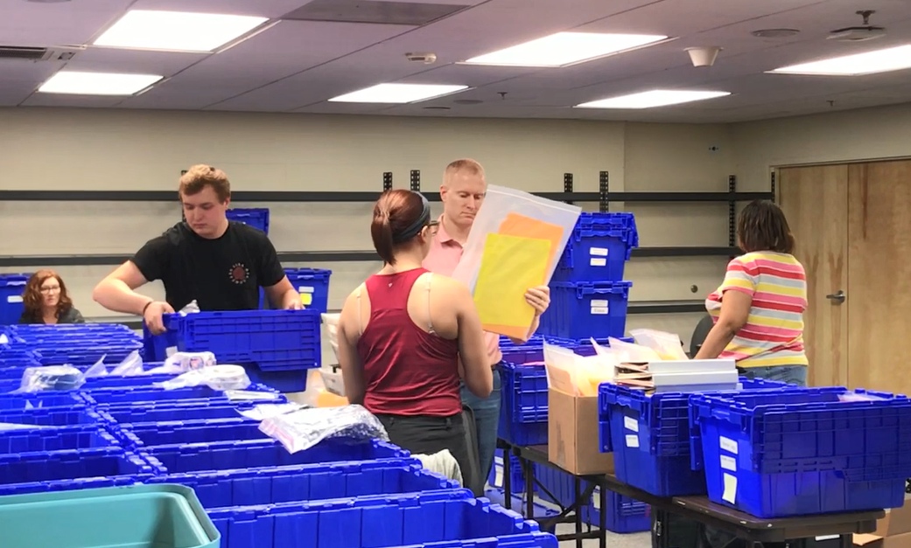
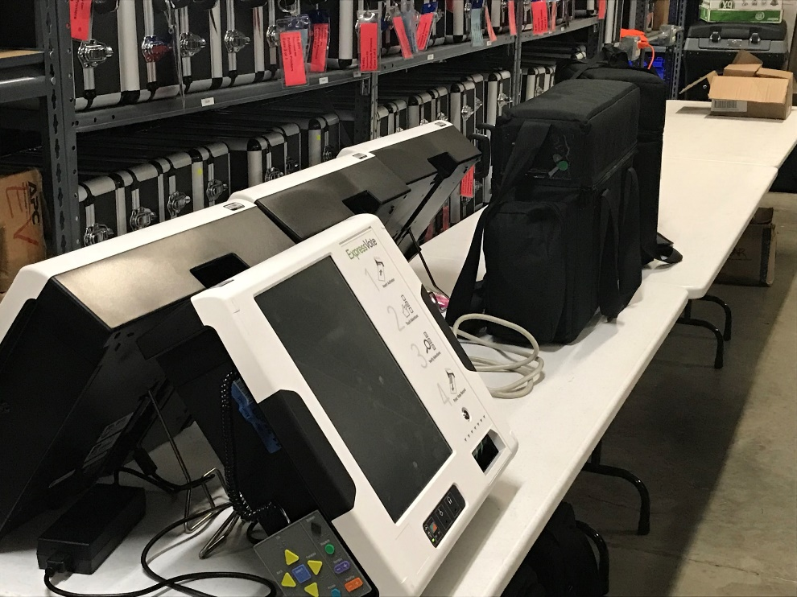
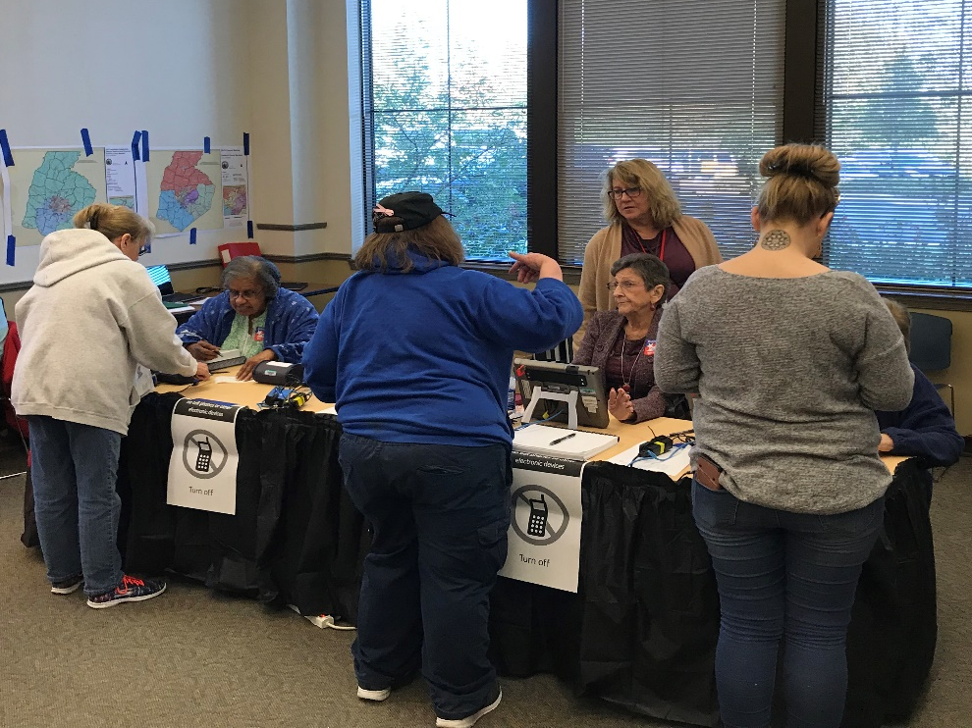
Duties of the Board of Elections
Each polling place needs:
Accessibility survey
Electrical capacity and wireless signal strength testing
Public notice
Board deliberation
Signed contract or MOU
Voter notification
Voting equipment programming
Ballot proofing
Site plan
Supply purchasing and packing
Training and assignment of Election Judges

Slide 13
The Calendar Ahead
2021
November 15: Deadline for Redistricting Commission Plan
December 15: Deadline for Council to Hold Public Hearing
2022
January 12: General Assembly Convenes
February 13: Deadline for Council Plan to Become Law
February 22: Deadline to File a Certificate of Candidacy
March 4: Deadline for Candidate to Withdraw
March 9: Deadline to Challenge Residency of a Candidate
March 29: Deadline to Create or Change Boundary or Polling Place
April 11: General Assembly Adjourns
April 25: Deadline for Certification of the Ballot
April 28: Printing of Ballots Begins
June 16: Early Voting Begins
June 28: Election Day

Slide 14
Questions?

