Slide 1


The Making of Data Center Alley – How Ashburn, VA Became the Top Data Center Market in the World

Slide 2
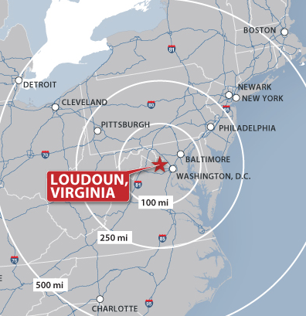
Loudoun, Virginia
Notes:
25 miles (40 km) from nation’s capital, 25 minutes from scenic farmland
#1 median household income for jurisdictions with a population of 65,000 or greater
#1 in business growth in Virginia – SmartAsset, 2017
International Economic Development Council recently named Loudoun County as a top-performing EDO
#1 median household income in the U.S.
#1 data center market; 70% of the world’s internet traffic
Forbes.com Ranks Virginia No. 5 Best State for Business 2017
Investment study by smart asset: The annual study ranked counties in four areas: (1) the growth in the number of businesses established in the county over a three-year time frame; (2) GDP growth in the local economy; (3) the number of new building permits per 1,000 homes, and (4) the total municipal bond debt raised by the county over the past five years, divided by the number of residents.

Slide 3
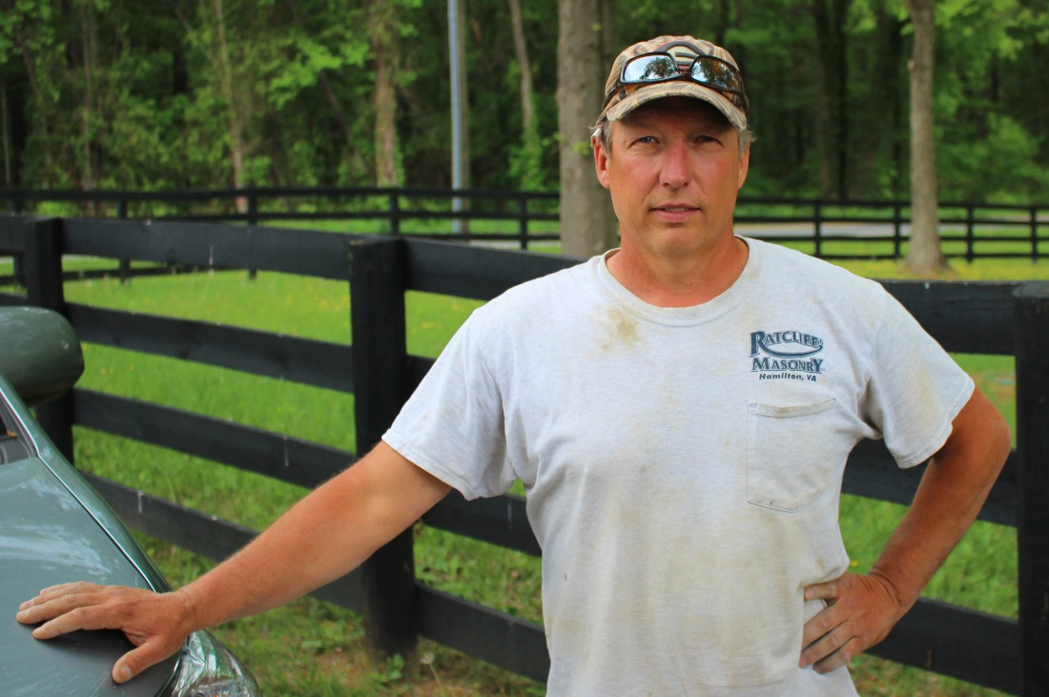
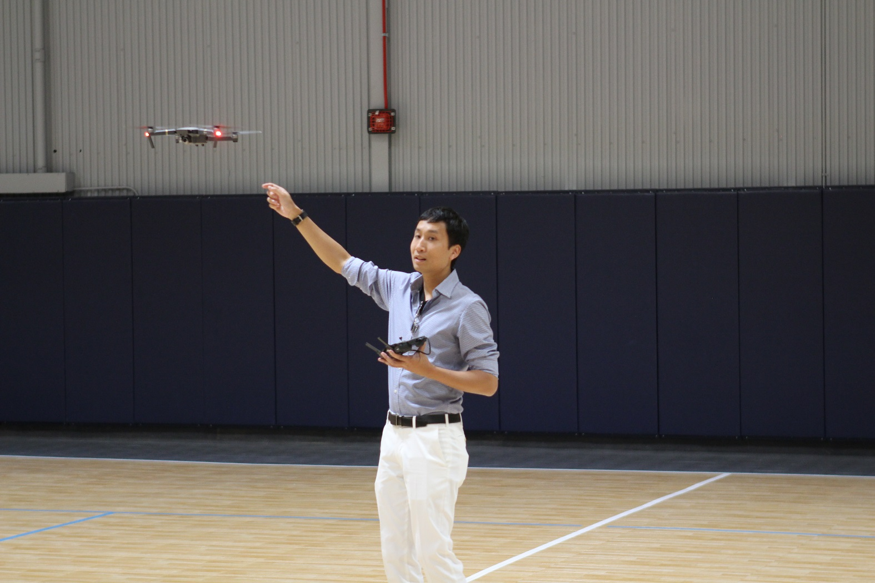


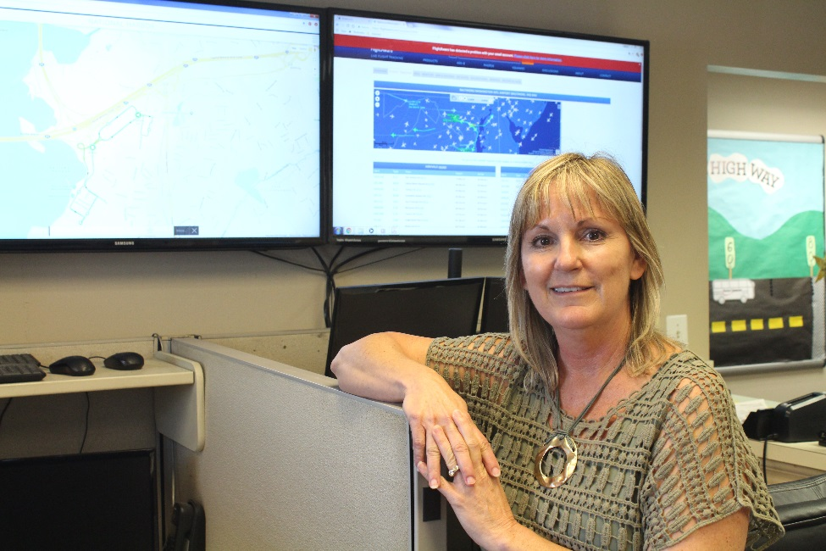
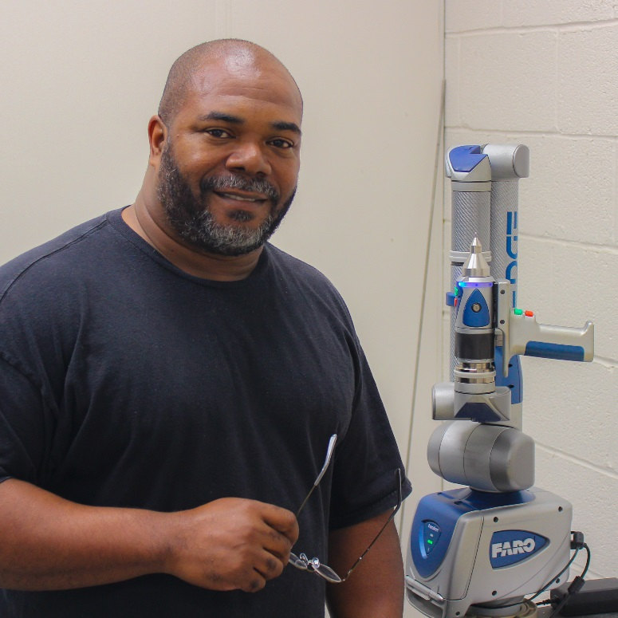
Our vision is a
diverse and globally competitive Loudoun economy.

Slide 4

Our mission is to strengthen and diversify Loudoun’s economy by providing world-class and innovative customer-focused services to attract, grow and retain targeted businesses of all sizes.

Slide 5
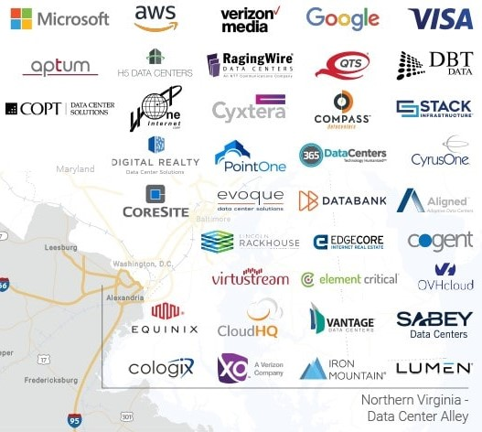
Data Center Alley

Slide 6
Loudoun’s Data Center Numbers
2,800,000,000
750,000,000
31,000,000
12,000
<1

Slide 7
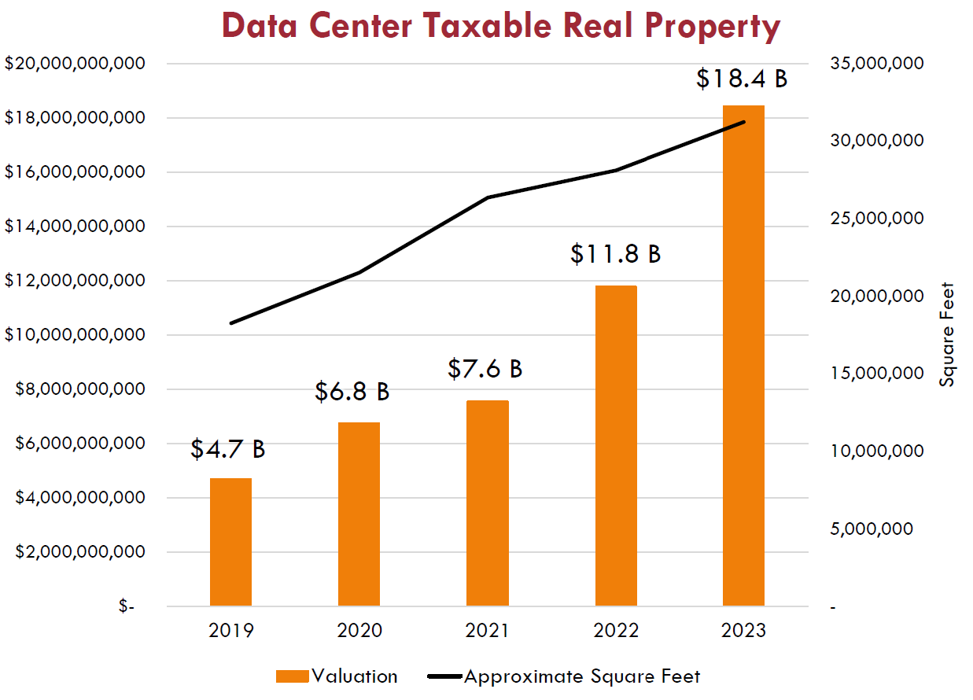

Slide 8
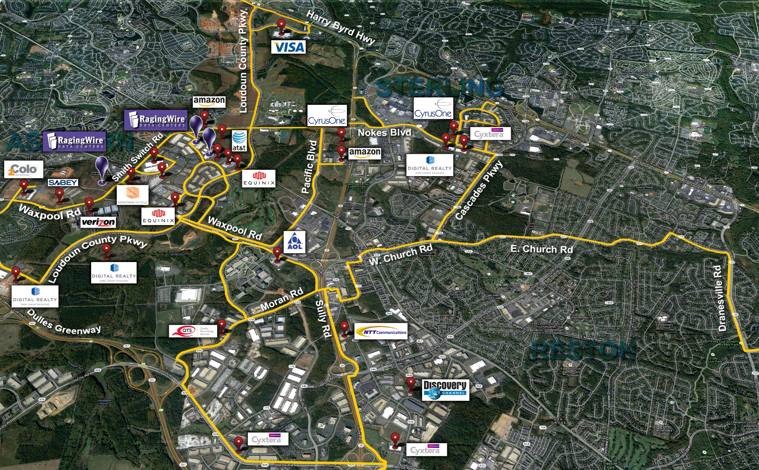
Data Center Alley

Slide 10
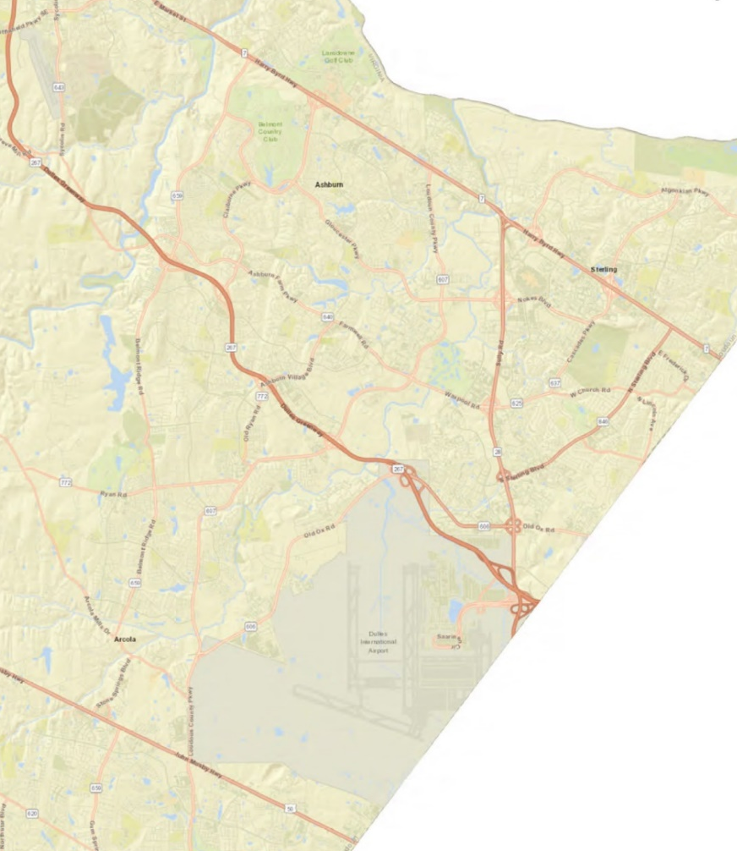

Slide 11
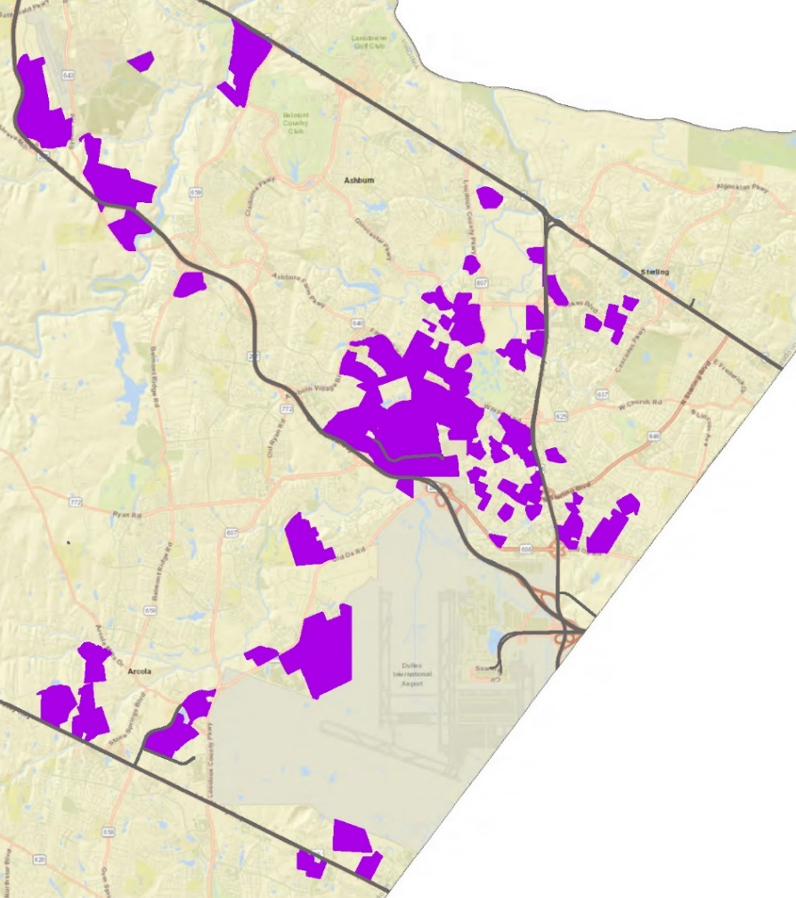

Slide 12
Ashburn, VA Advantages
Land
Fiber
Utilities
Taxes
Business Environment
Workforce
Notes:
Land
Fiber
Power
International Airport
Taxes
Water
Active Industry Association

Slide 13

Power
Actual Peak Load: Over 2.8GW of Load
Annual Load Increase: 100-200 MWs
500kV Transmission Ring (the first of its kind) feeding multiple 230kV transmission networks in Ashburn
New “Southern” high-voltage line will be completed in late 2026
New “Northern” high-voltage line to be completed in 2028
Substations served multiple 230kV sources
Dominion Energy currently has more than 15 substations in service or under development in approximately a 1.5 mile radius

Slide 14
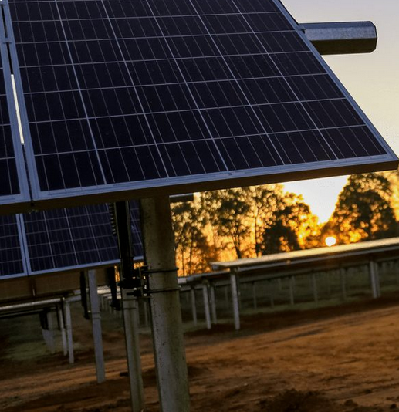

Commitment to Sustainability
Currently generate 2,600 MW of clean energy in ten states.
Coastal Virginia Offshore Wind project is the first offshore wind initiative in the mid-Atlantic.
Committed to 3,000 megawatts of solar and wind energy under development or in operation by later this year.
16,000 MW planned.

Slide 15
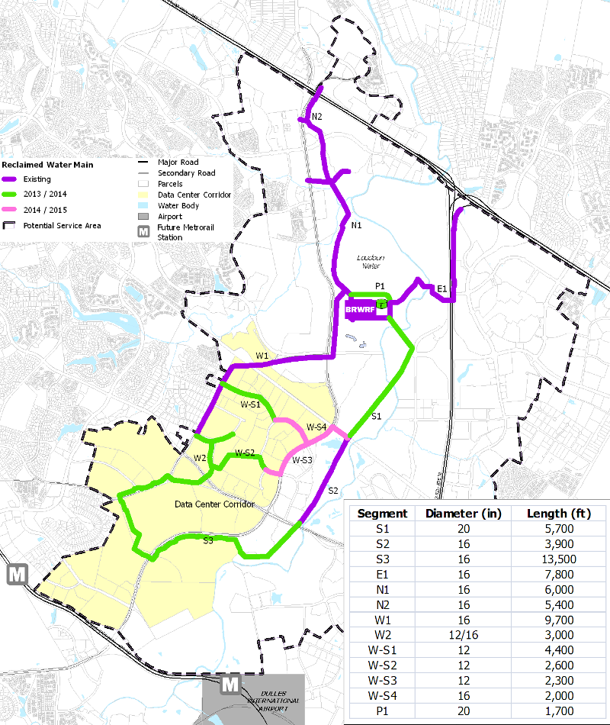

Water
20 miles of pipeline
40 facilities connected
675 million gallons of reclaimed water used

Slide 16

Tax Policy and Financial Advantages
Stable tax environment
Stable energy prices
World-class sales and use tax incentive
More than 70 data centers are eligible for the sales tax break
$124.5 million saved by data centers in 2021
Spurred more than $1.2 billion in taxes in Virginia in 2021

Slide 17


Data Center Legislation
3 Types of Locally Taxable Data Center Components
SB 513 (Sen. Jeremy McPike)/HB 791 (Del. Joe McNamara).
These bills provide certainty by aligning localities with a single approach for assessing data center fixtures. This treats data center fixtures the same regardless of whether they are owned by data center owners or tenants and provides certainty to support data center investment.

Slide 18
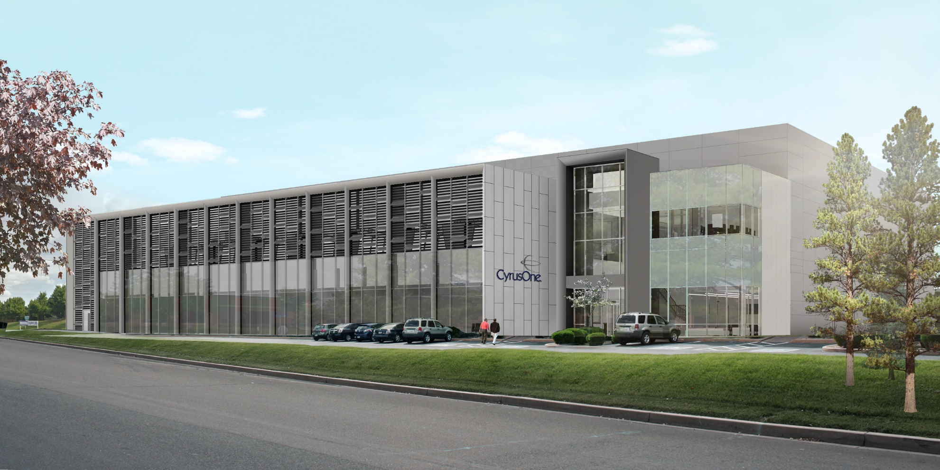
Business Environment
CyrusOne, Hitt Contracting, Bowman Consulting, Loudoun County and many other partners constructed a world-class data center in 6 months, believed to be the fastest data center construction on record

Slide 19

Workforce

Slide 20

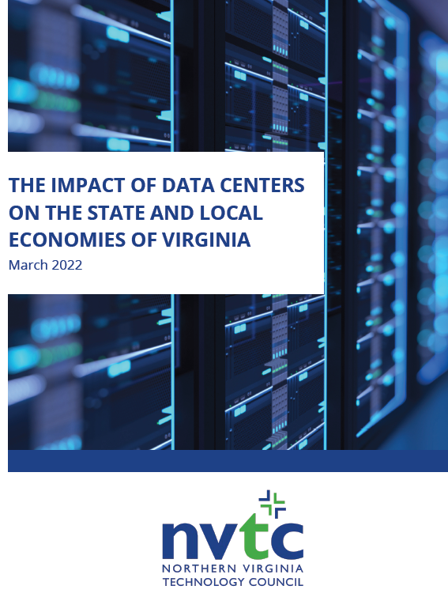
Metrics And Reporting

Slide 21

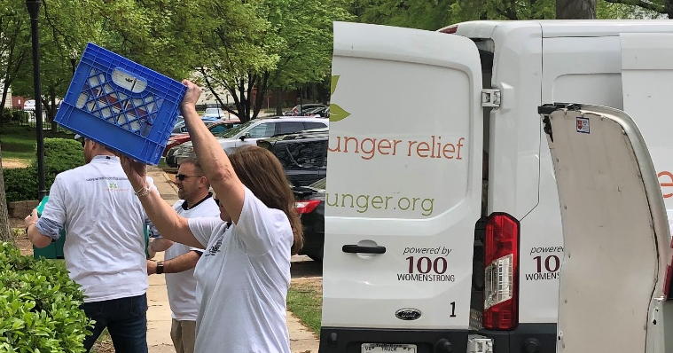


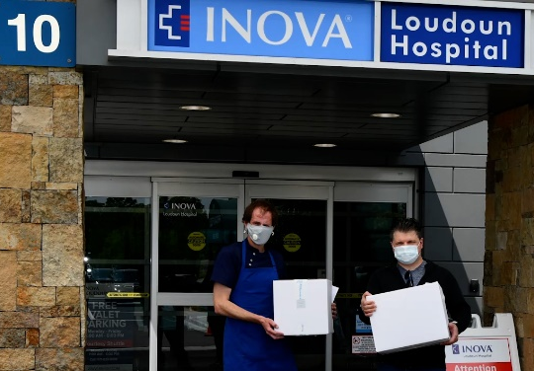

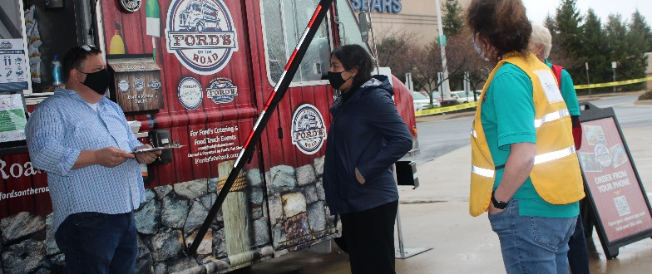

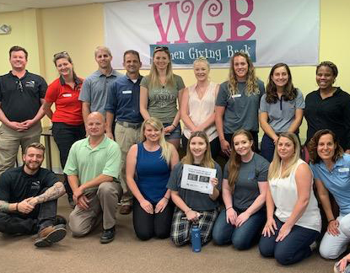
Giving Back to the Community

Slide 22

If we can help you in any way, please call Buddy Rizer at 703-777-0592 or email Buddy.Rizer@Loudoun.gov

