Slide 1


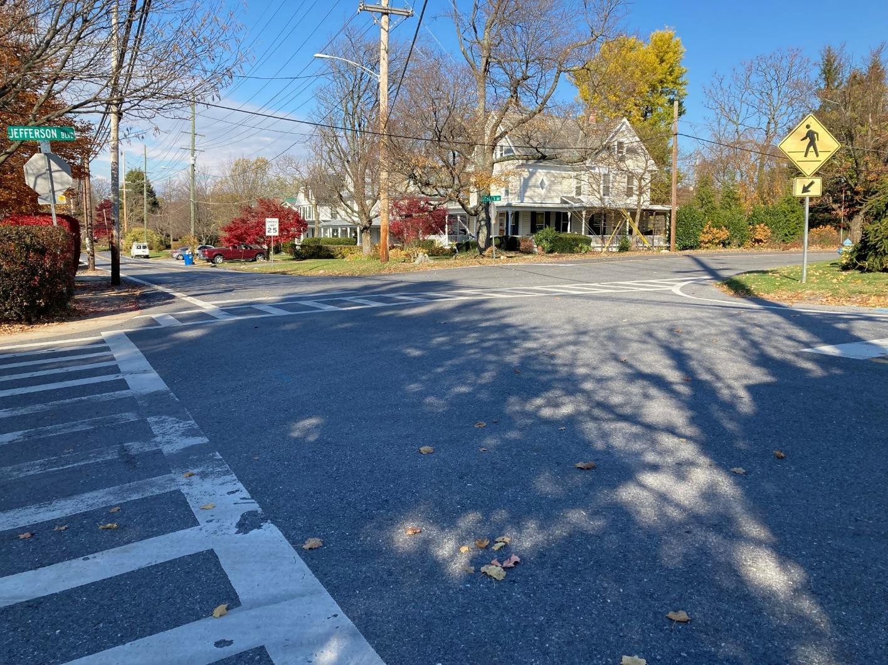


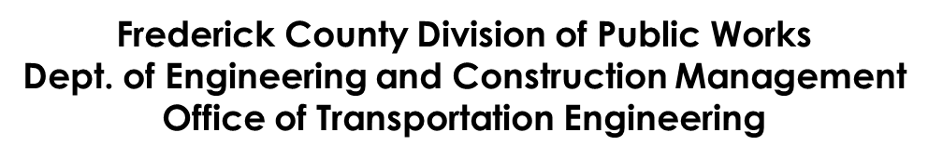
Braddock Heights Improvements Project
4th Community Meeting
Middletown Primary School
September 23, 2025, 7:00 p.m.

Slide 2
Project Team
Brandon Henderson – Project Manager
Elbert Maravilla – Assistant Chief – Office of Transportation Engineering
Tracy Diggs – Chief – Office of Transportation Engineering
GPI – Engineering Consultants

Slide 3
Project Timeline
1st community meeting Dec 2021
10% Design
3rd community meeting Dec 2024
65% Design
5th community meeting 2026
Begin Construction Fall 2027
Concept layouts
2nd community meeting Apr 2023
30% Design
4th community meeting Sep 2025
90%-100% Design Fall 2026

Slide 4
Project Overview
Improvements will address:
Pedestrian Accessibility and Connectivity
Traffic Calming and Safety
Roadway Drainage Issues
The project is funded 100% by Frederick County Government. No community match.

Slide 5
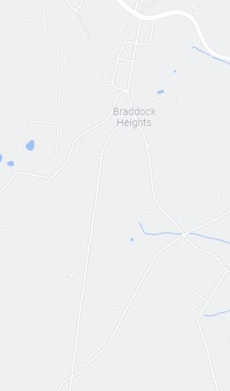





Project Location Map
US 40A
Roads:
Maryland Ave
Schley Ave
Jefferson Blvd
MARYLAND AVE
SCHLEY AVE
JEFFERSON BLVD
Cherry Lane / S. Clifton Road

Slide 6
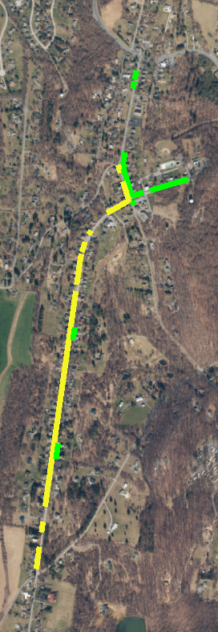
Existing Pedestrian Connectivity
US 40 ALT
MARYLAND AVE
Church
Pool
SCHLEY
Accessible Sidewalk
Sidewalk Doubling as Parking Area
Place of Interest
Fire Station
Post Office
JEFFERSON BLVD

Slide 7
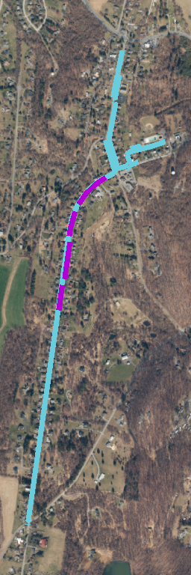
Proposed Pedestrian Connectivity
US 40 ALT
MARYLAND AVE
Church
Pool
SCHLEY
Fire Station
Post Office
Accessible Sidewalk
Designated Areas for Roadside Parking
Place of Interest
JEFFERSON BLVD

Slide 8
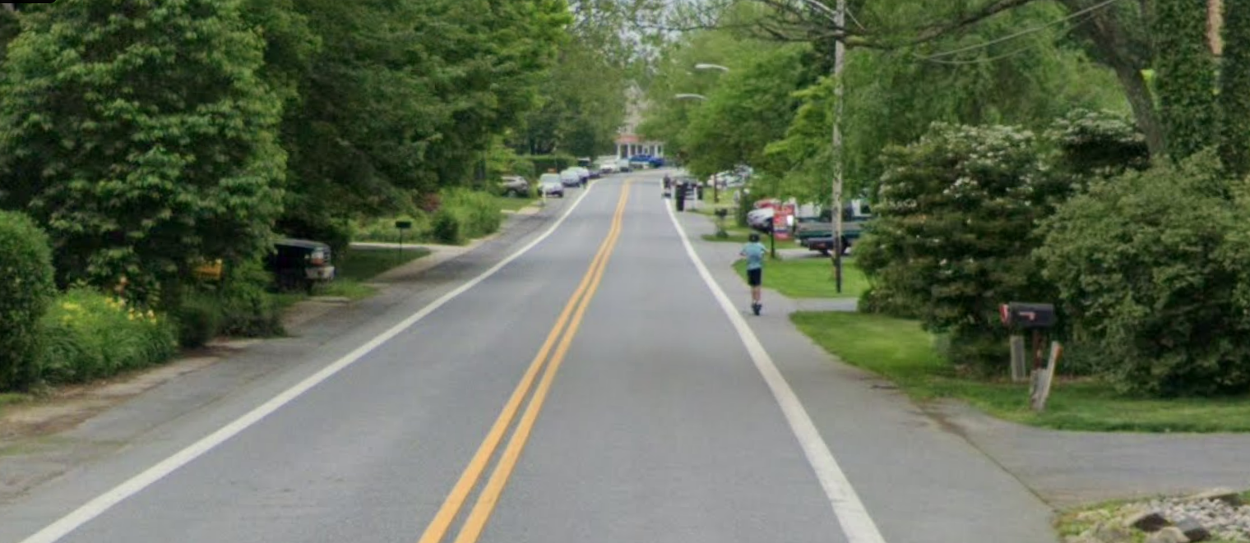
Americans with Disabilities Act (ADA)
The County is required by Maryland State Highway Administration (SHA) to bring pedestrian facilities in the County into compliance.
This includes:
Sidewalks
Ramps
Pedestrian Crossings

Slide 9
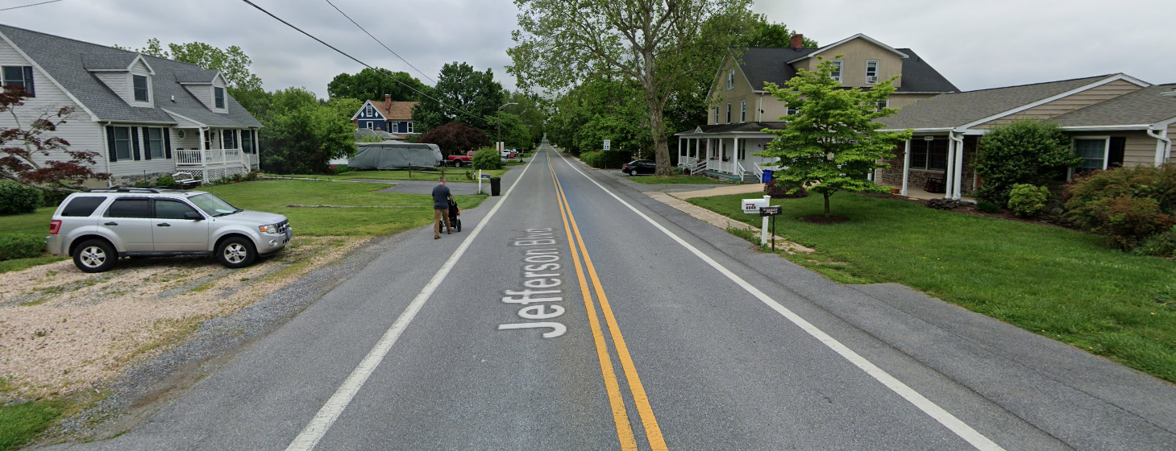
Accessible Sidewalk Design
5 feet wide is federally recommended
Pinch points of 3 feet wide at constraints
Grass buffer or curb and gutter adjacent to prevent parking on top of sidewalk
Ramps provided at intersections
Striped and signed crosswalks
Driveway aprons
Note: Frederick County codes require all residents to maintain sidewalk adjacent to their property.

Slide 10
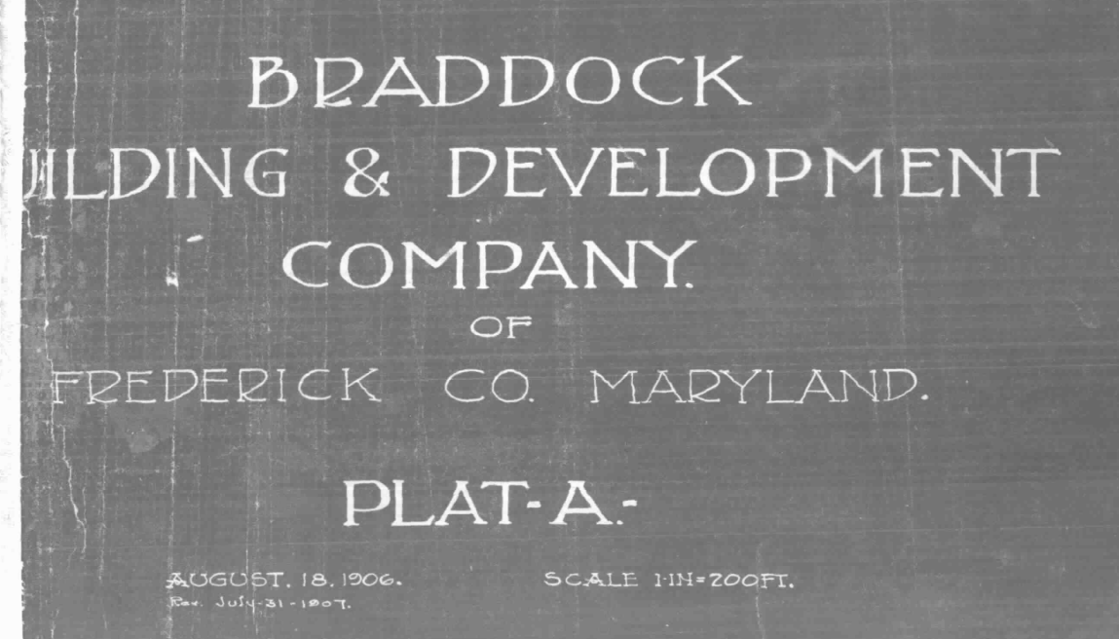
Existing Right of Way

Slide 11
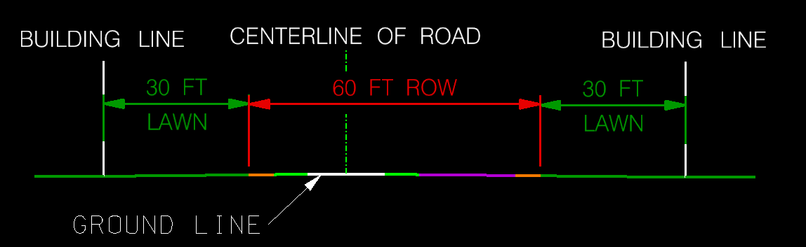
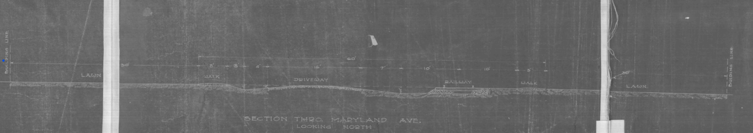
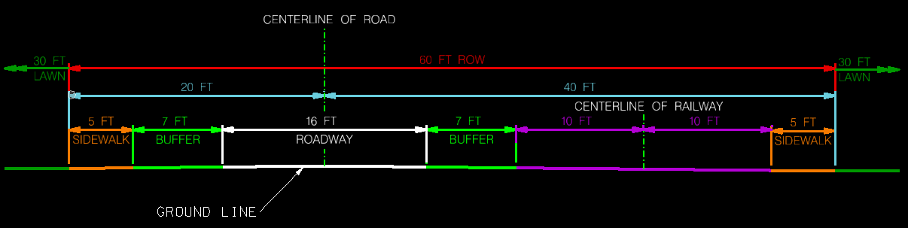

Slide 12
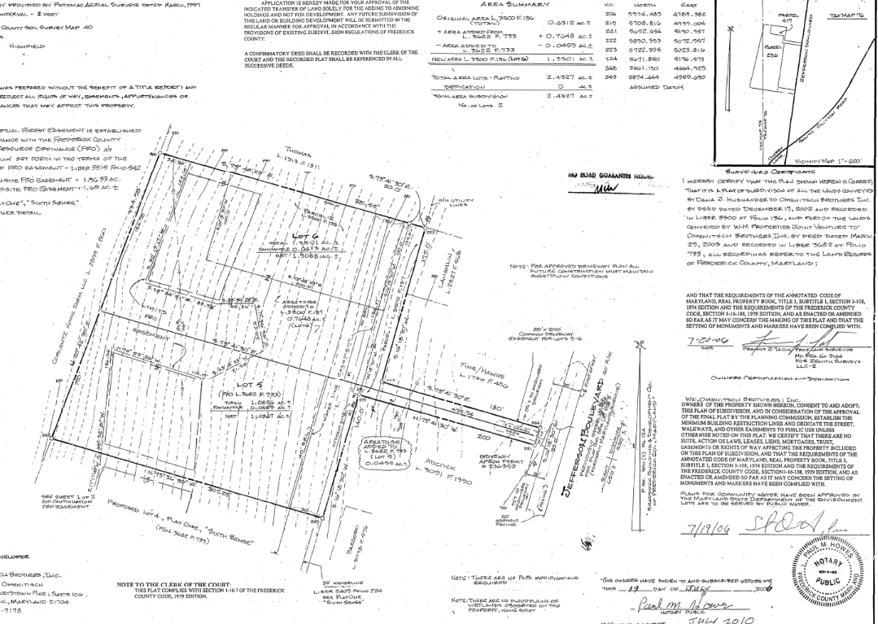
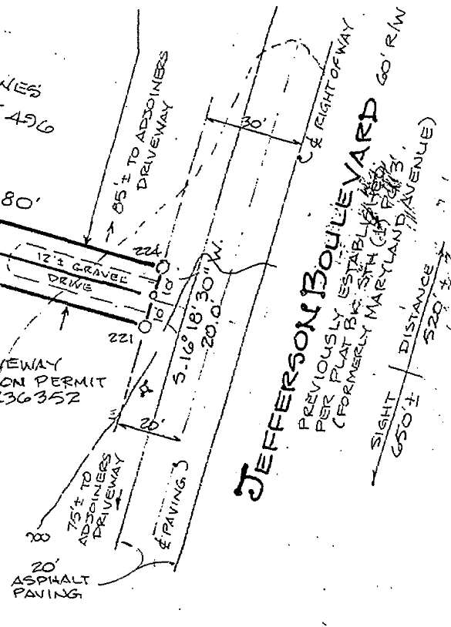
Centerline of Road

Slide 13
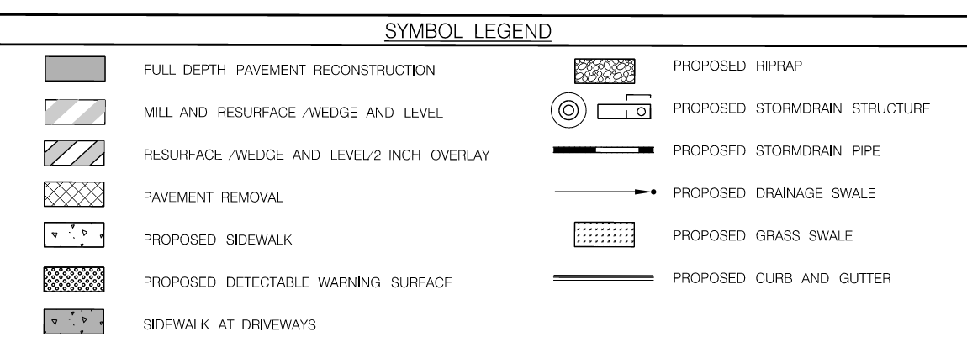
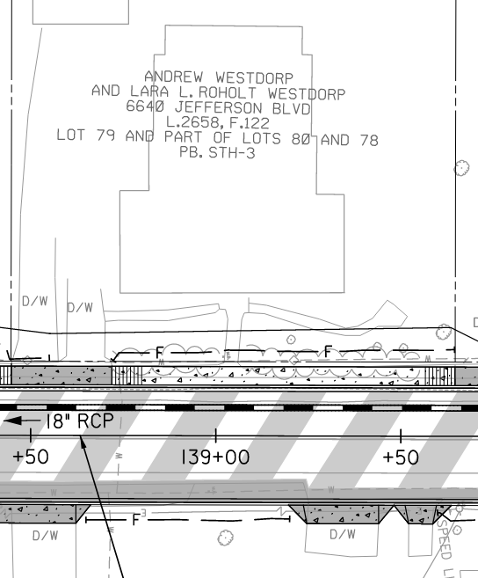
Example – Close Up

Slide 14
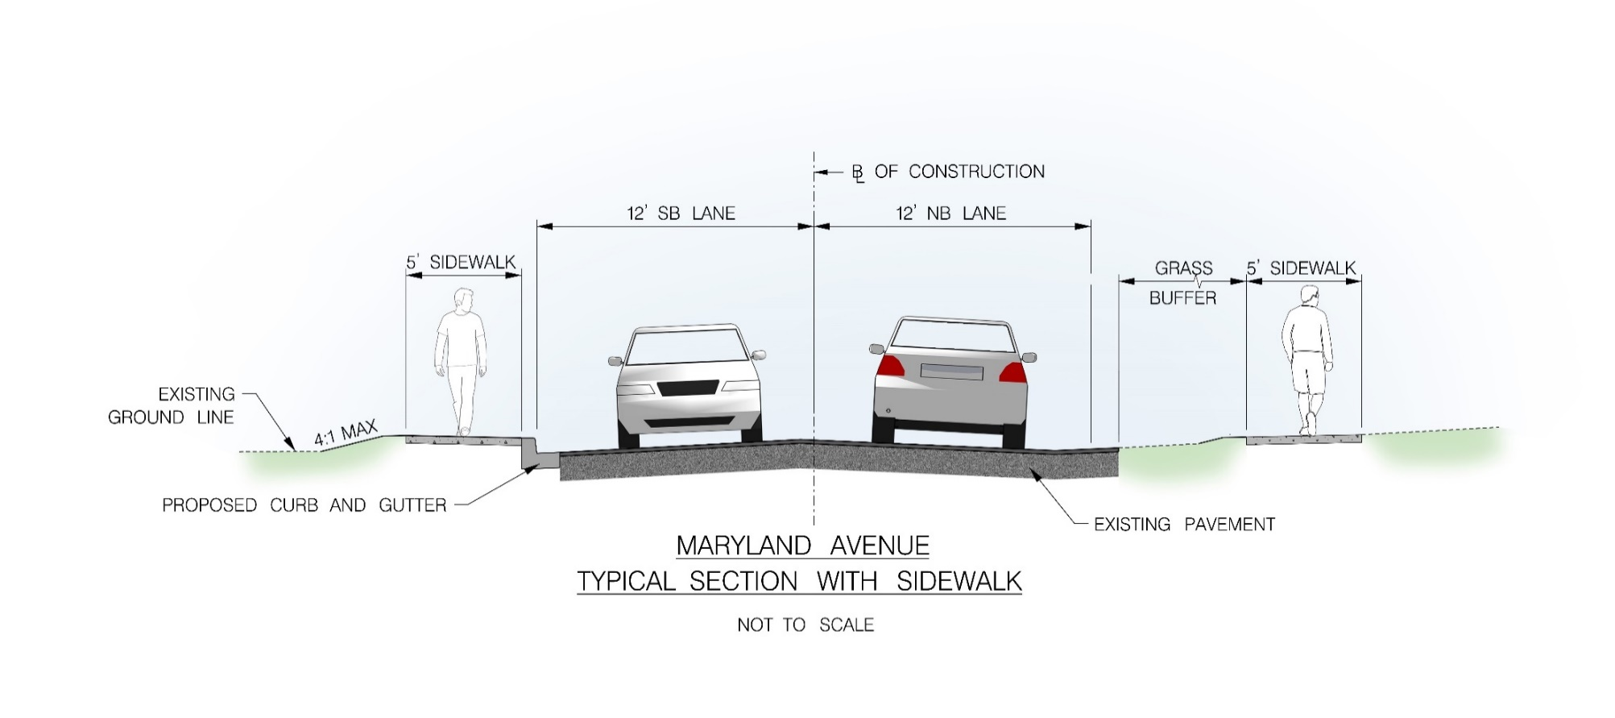
Typical Sidewalk Application

Slide 15
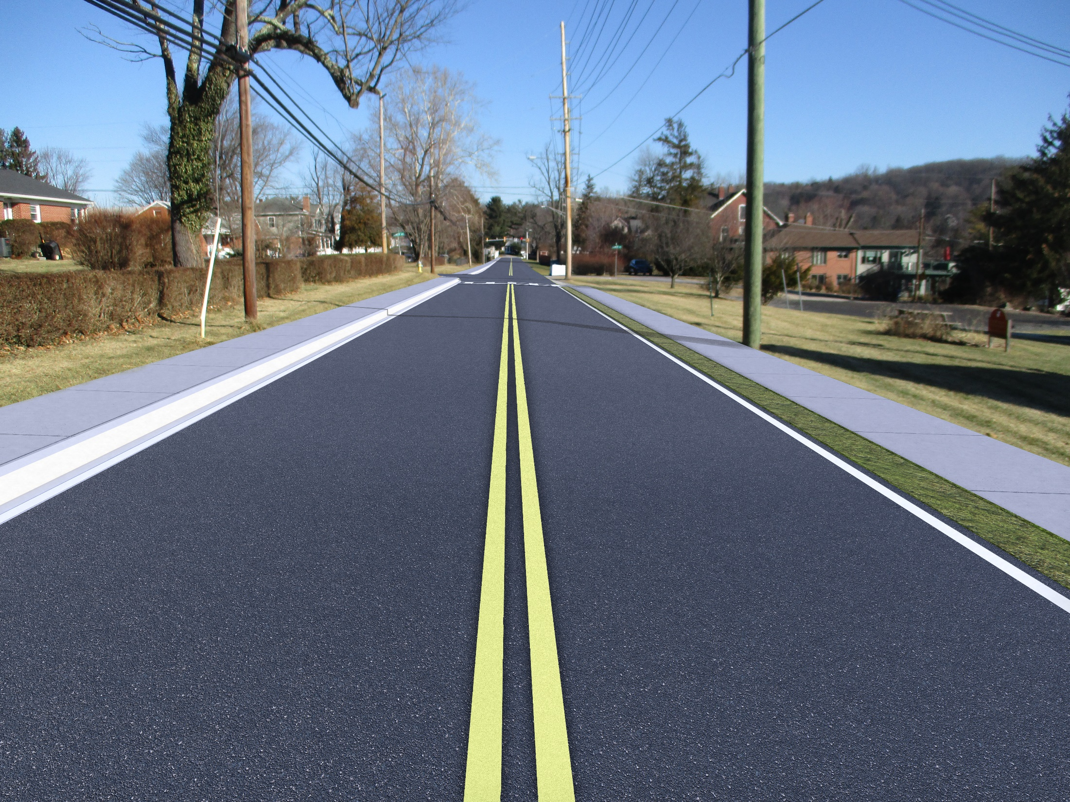
Maryland Ave looking towards US 40

Slide 16
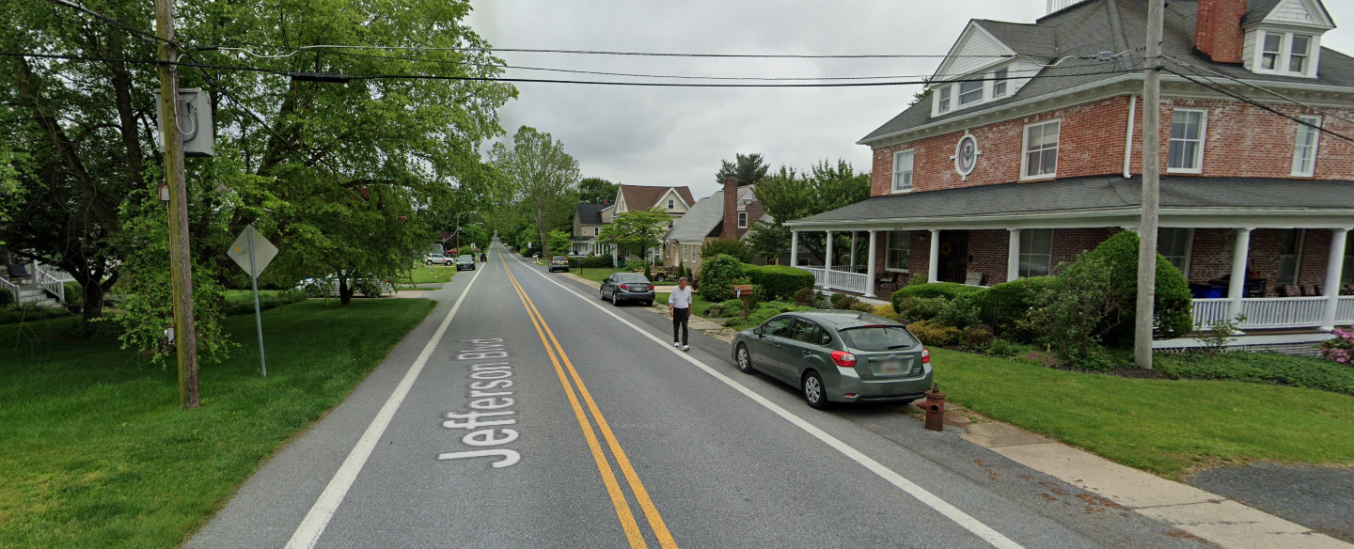
Street Parking
Proposed 8 feet wide shoulder parking areas starting at 6613 Jefferson Blvd. to Maryland Ave.
Many properties have dedicated driveways

Slide 17
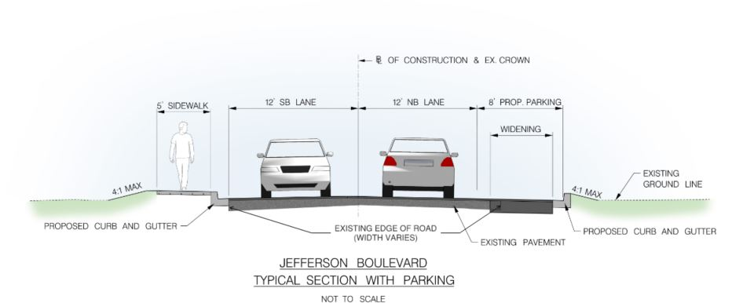
Typical Sidewalk and Parking Application

Slide 18
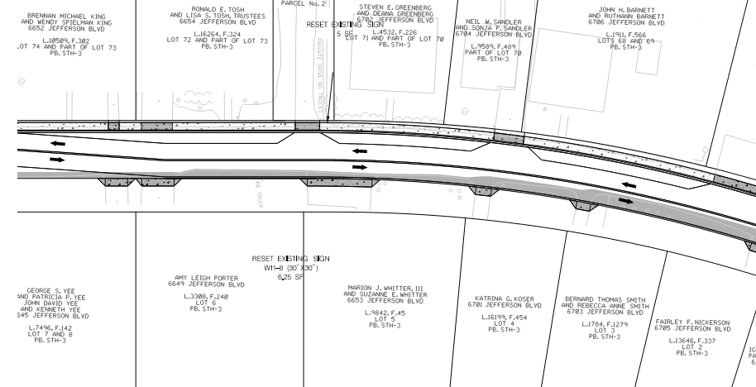
On street parking

Slide 19
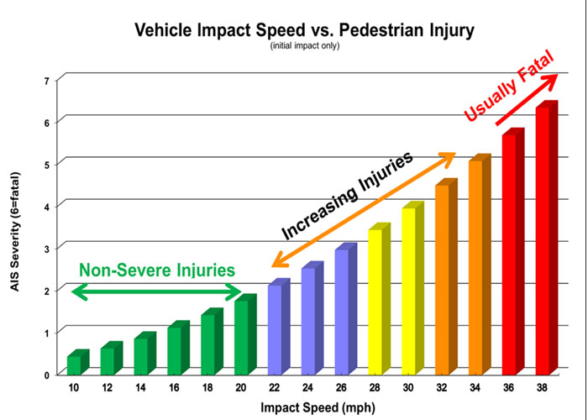
Traffic Calming Goals
To reduce vehicle speeds in residential areas.
Improve safety for pedestrians and cyclists.
Give pedestrians and bicyclists time to detect and avoid vehicles.
Reduce the severity of injury on impact to pedestrians, which is much greater at higher speeds.

Slide 20
Typical Traffic Calming Techniques
Vertical deflections (speed humps, bumps, tables, and cushions)
Horizontal shifts (chicanes, roundabouts)
Roadway narrowing (curb bump outs)

Slide 21
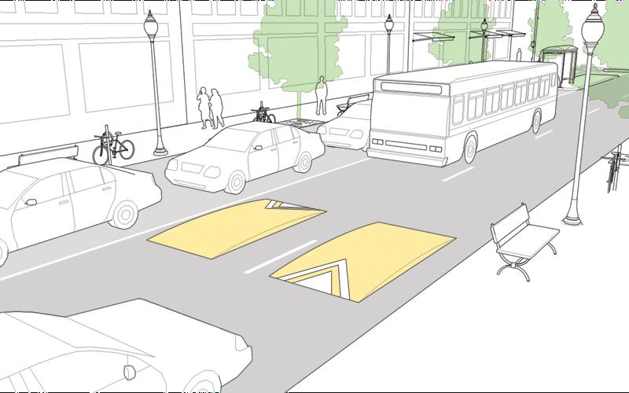
Speed Cushion
Image from the NACTO Urban Street Design Guide

Slide 22
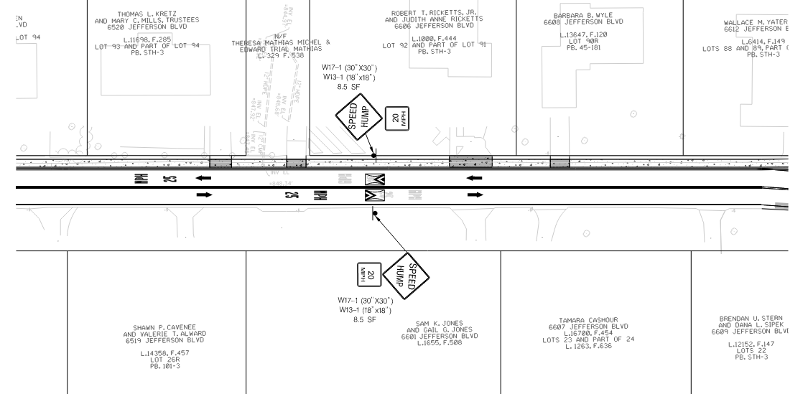
Example
Speed cushion

Slide 23
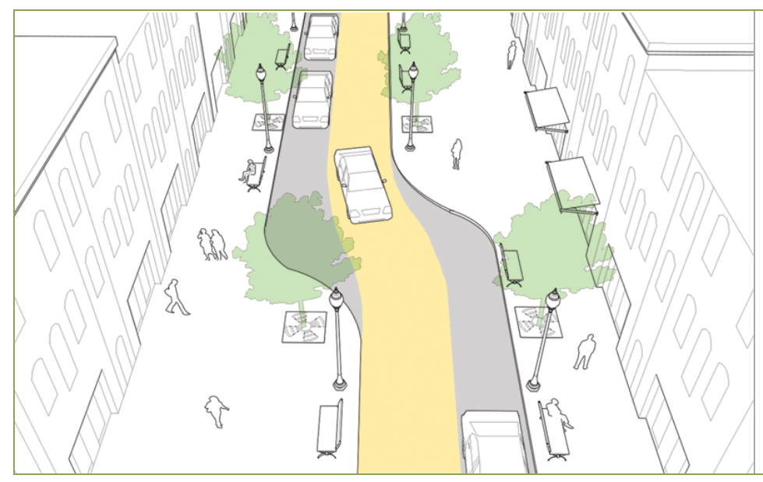
Chicane
Image from the NACTO Urban Street Design Guide

Slide 24
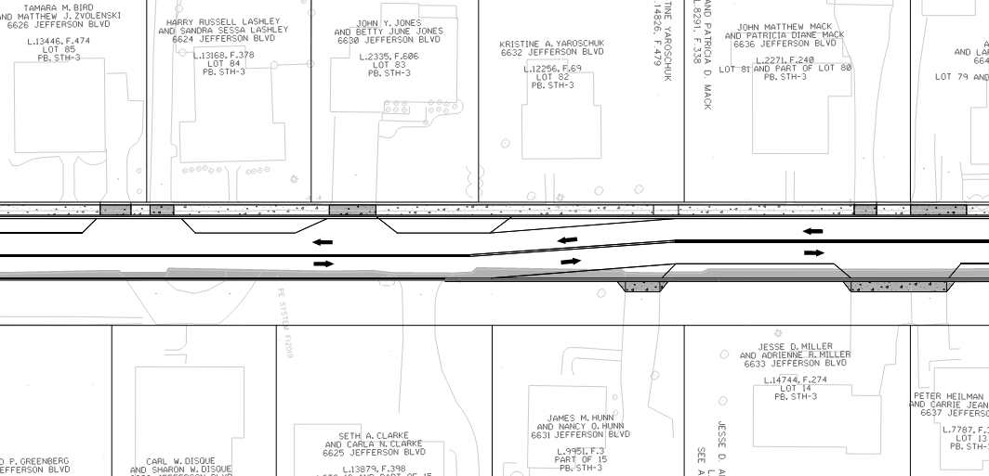
Example

Slide 25
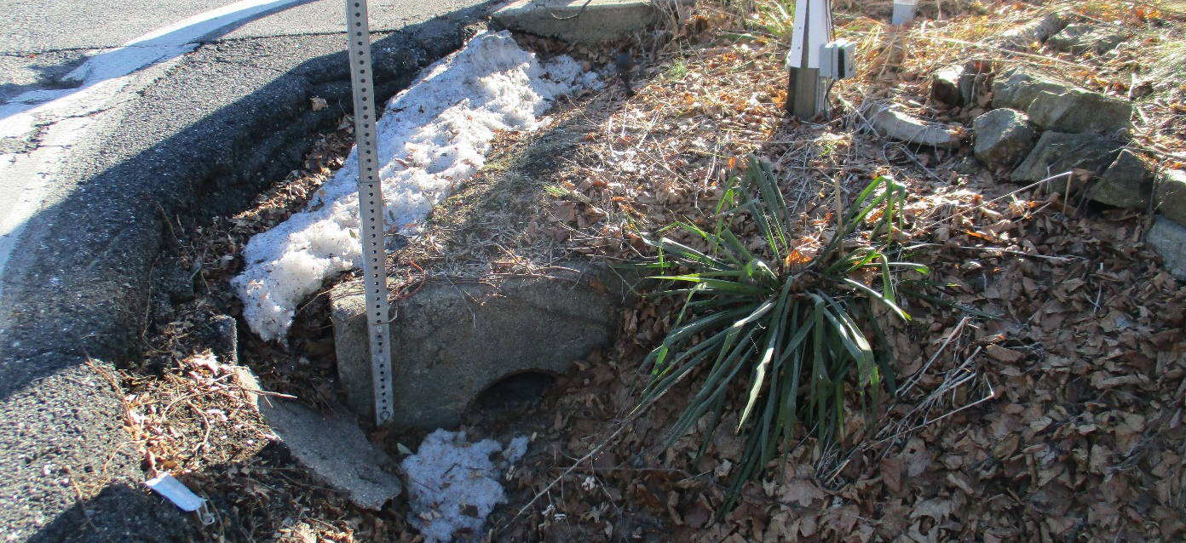
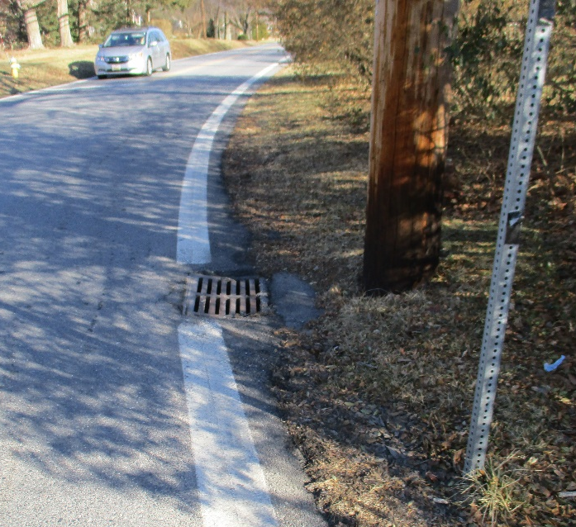
Roadway Drainage
Upgrade and repair existing infrastructure impacted by the project
Install new drainage structures along proposed closed sections of roadway.

Slide 26
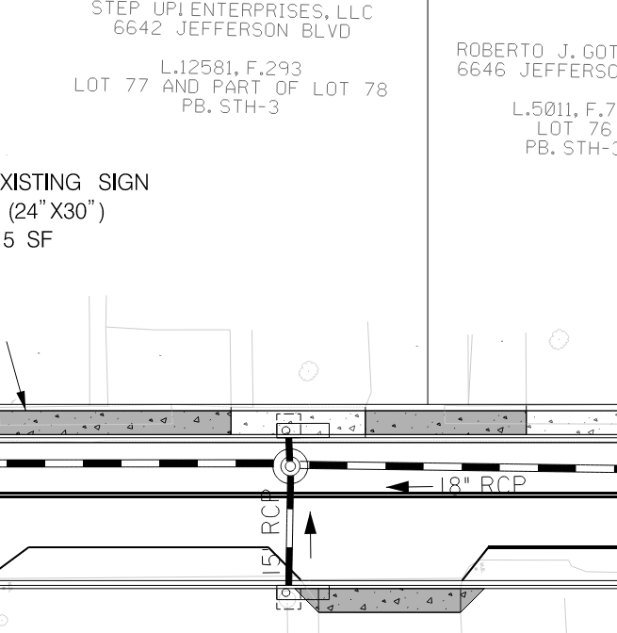
Example

Slide 27
Looking forward
Next milestone is at 65% design.
Refine roadway design.
Detailed storm drain analysis.
Update erosion and sediment control.
Revise stormwater management design.
Preliminary plats.

Slide 28
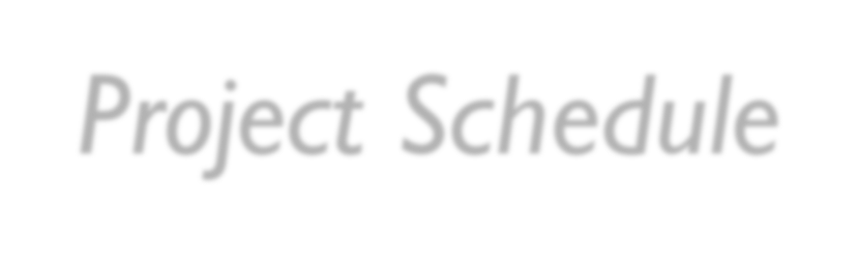
Project Schedule
Study Phase
July 2021 – January 2023
Design Phase
2024-2026
Construction Phase
Anticipated start in 2027 as currently proposed in the Fiscal 2025 Adopted Capital Improvement Program Budget FY2025-2030

Slide 29

Questions
We will now open the meeting for questions.
Meeting minutes from this meeting, including comments and responses, will be uploaded to our website.
Thank you!

